Slide 1

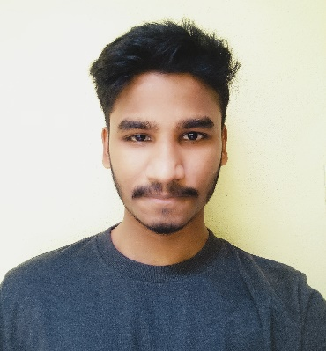


Yedla Bhanu Prakash
Education and certificates
Bachelor of Technology
Electronics and Communication Engineering : 2015 - 2019
Analyst/Software Engineer
Base Location : Mumbai
Email ID:
yedla.bhanu-prakash@capgemini.com
Skills
Bootstrap
Full Stack
Python
RDBMS
_{Mobile No : +91 9553975622}
Grade : A4
Strengths
A self driven learner with Front-End and Back-End knowledge. Passionate about implementing and launching new projects.
Ready to learn new technologies/Frameworks and implement them to further improve my knowledge.
A team player with good communication skill always ready to work for the enrichment of knowledge.
. Hands on experience in developing web pages
using HTML and CSS. Good understanding of
Document Object Model (DOM)
Achivement
RDBMS Project (Examination and Evaluation systems)
Database
SQL database – MySQL, OracleSQL, sqlite
I have done a mini RDBMS project called Examination and Evaluation systems using sqlplus. Created different tables with data and also created some front end pages using HTML and CSS.
Web Technologies
HTML
CSS
Javascript
Coded and designed Static Web Pages
Developed website with HTML5 and CSS3 to make website
more interactive and dynamic.
Additional Details
Good Communication Skills
Pressure Handling
Time Saving Skills
Also having knowledge on Python and RDBMS
Check out my work on GitHub & Video Profile
Presentation Title | Author | Date © Capgemini 2017. All rights reserved | 1

